Slide 1





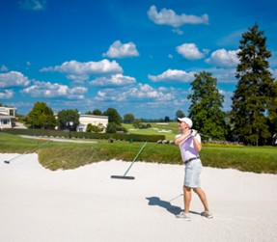


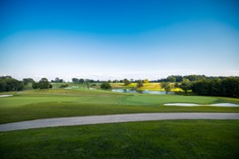
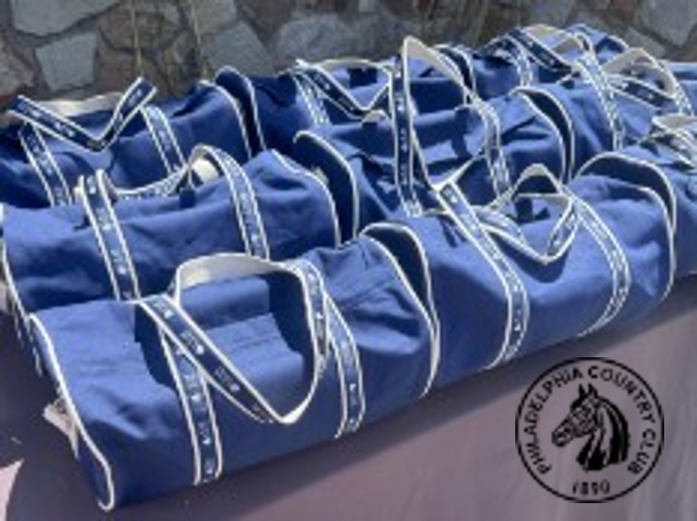


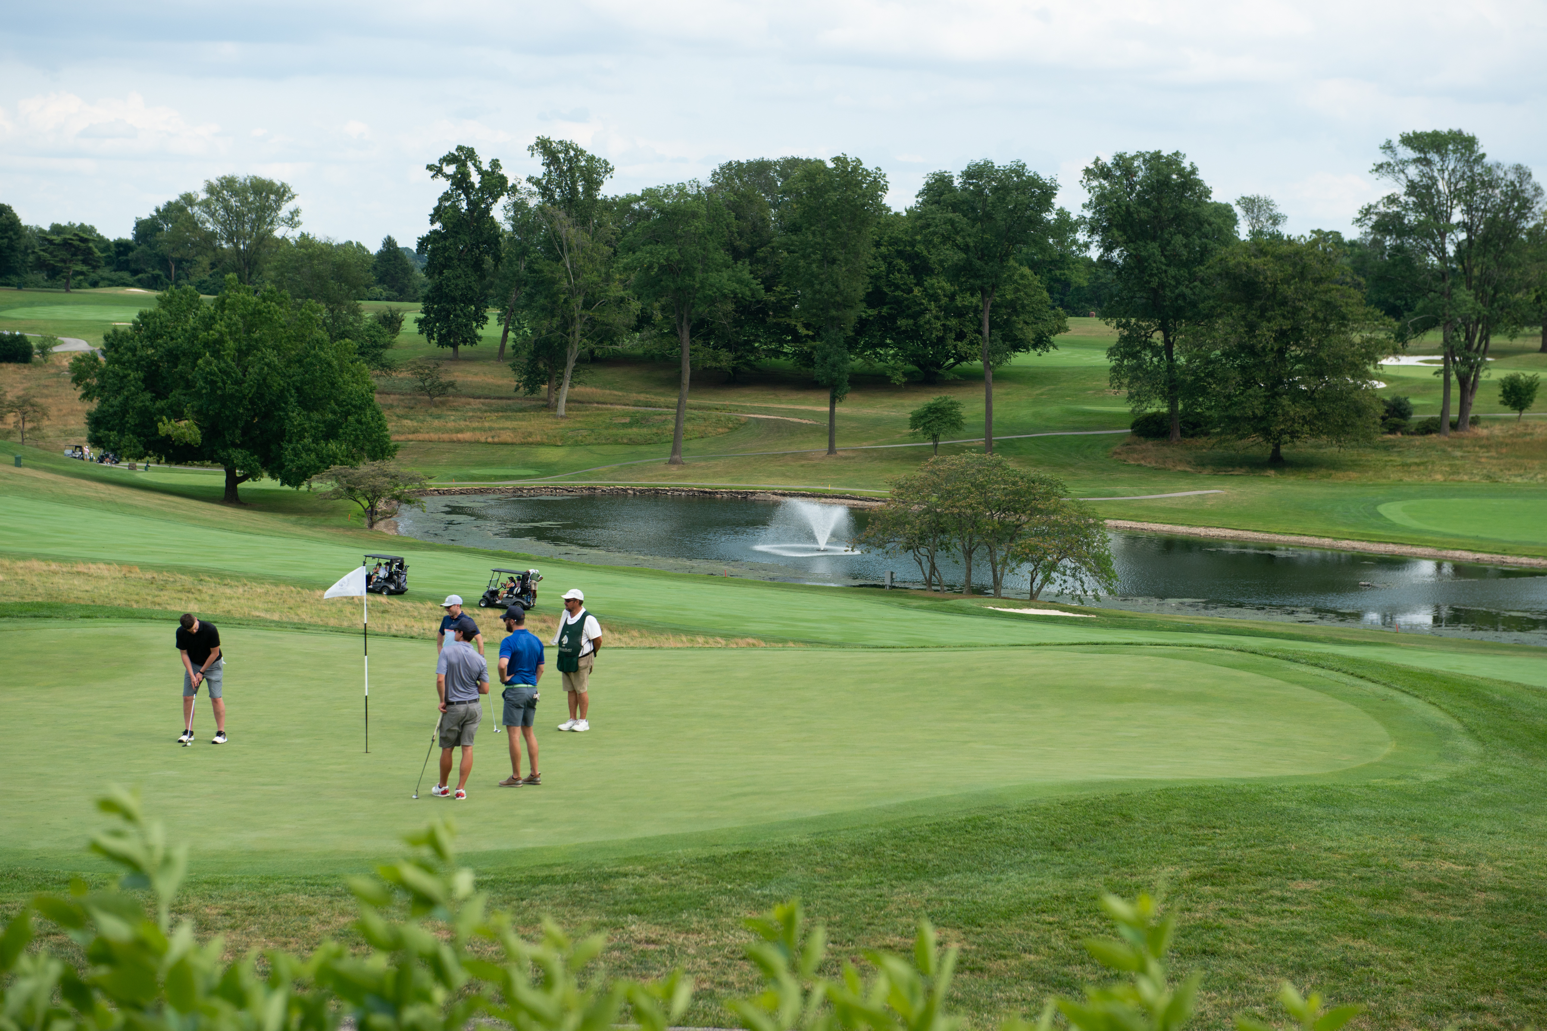
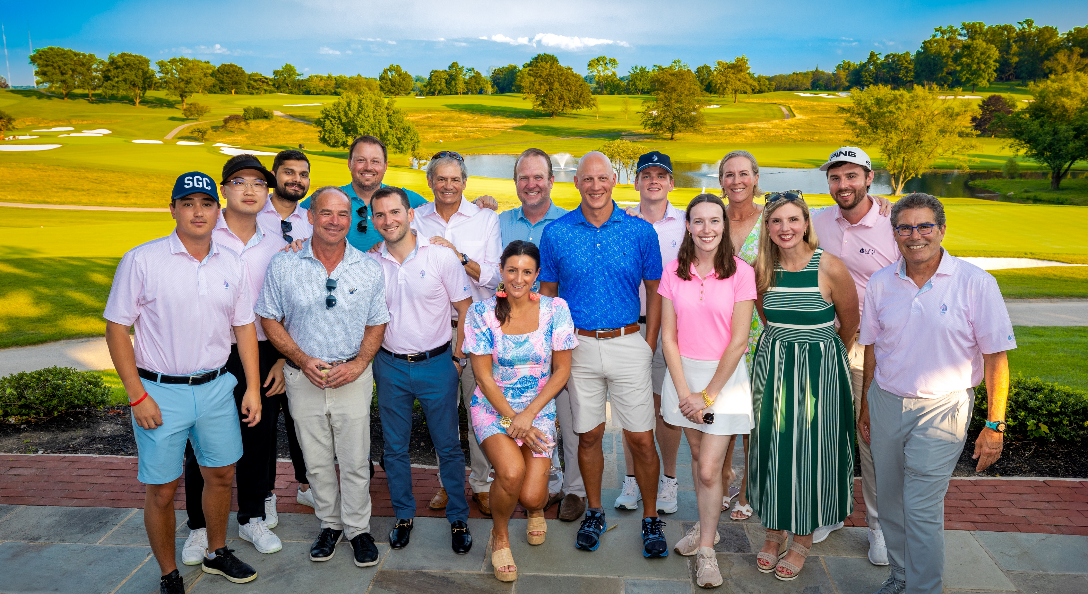
2025 Charity Golf Benefit
LEM Capital Charity Golf Benefit Raises Over $80,000 for Habitat for Humanity Philadelphia

Slide 2

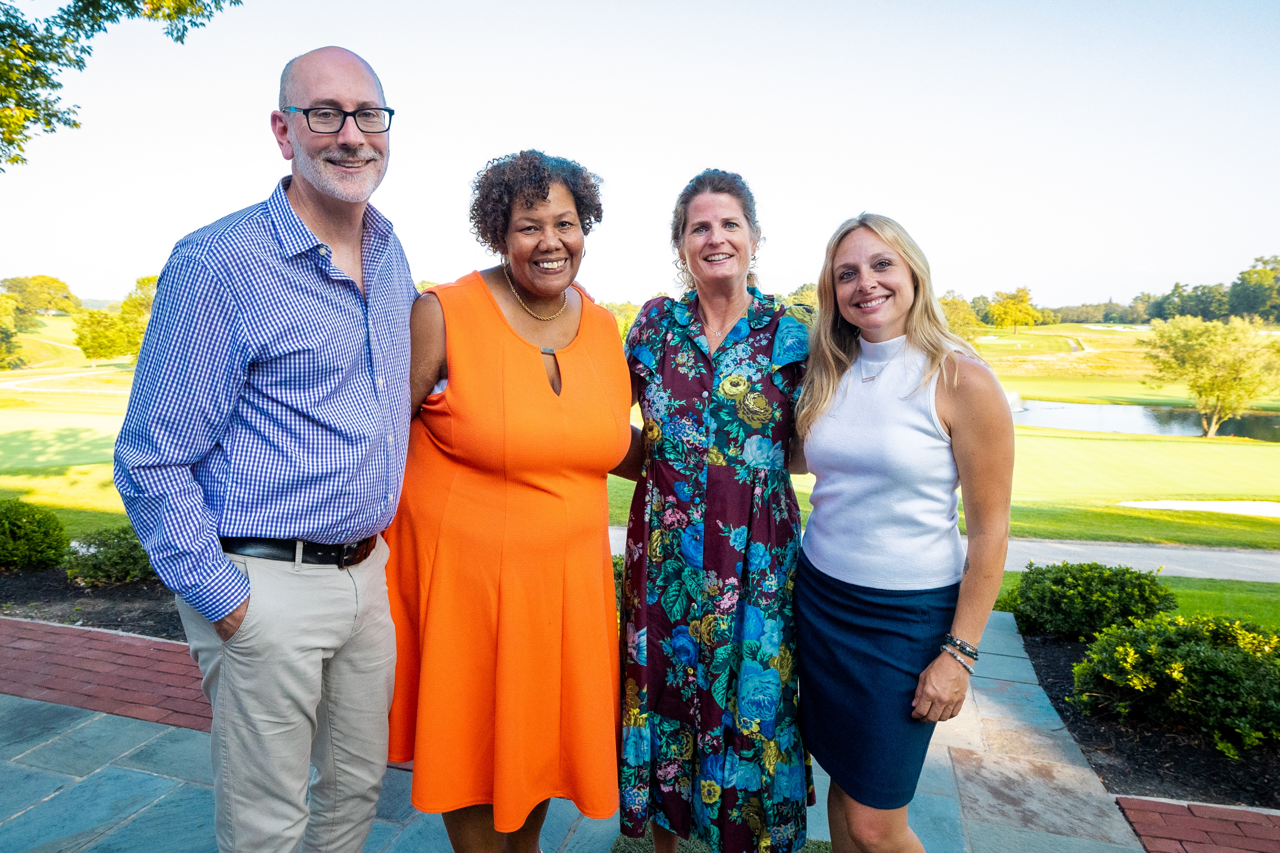
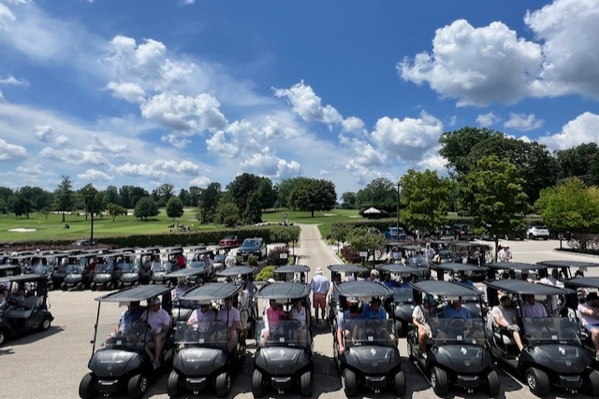





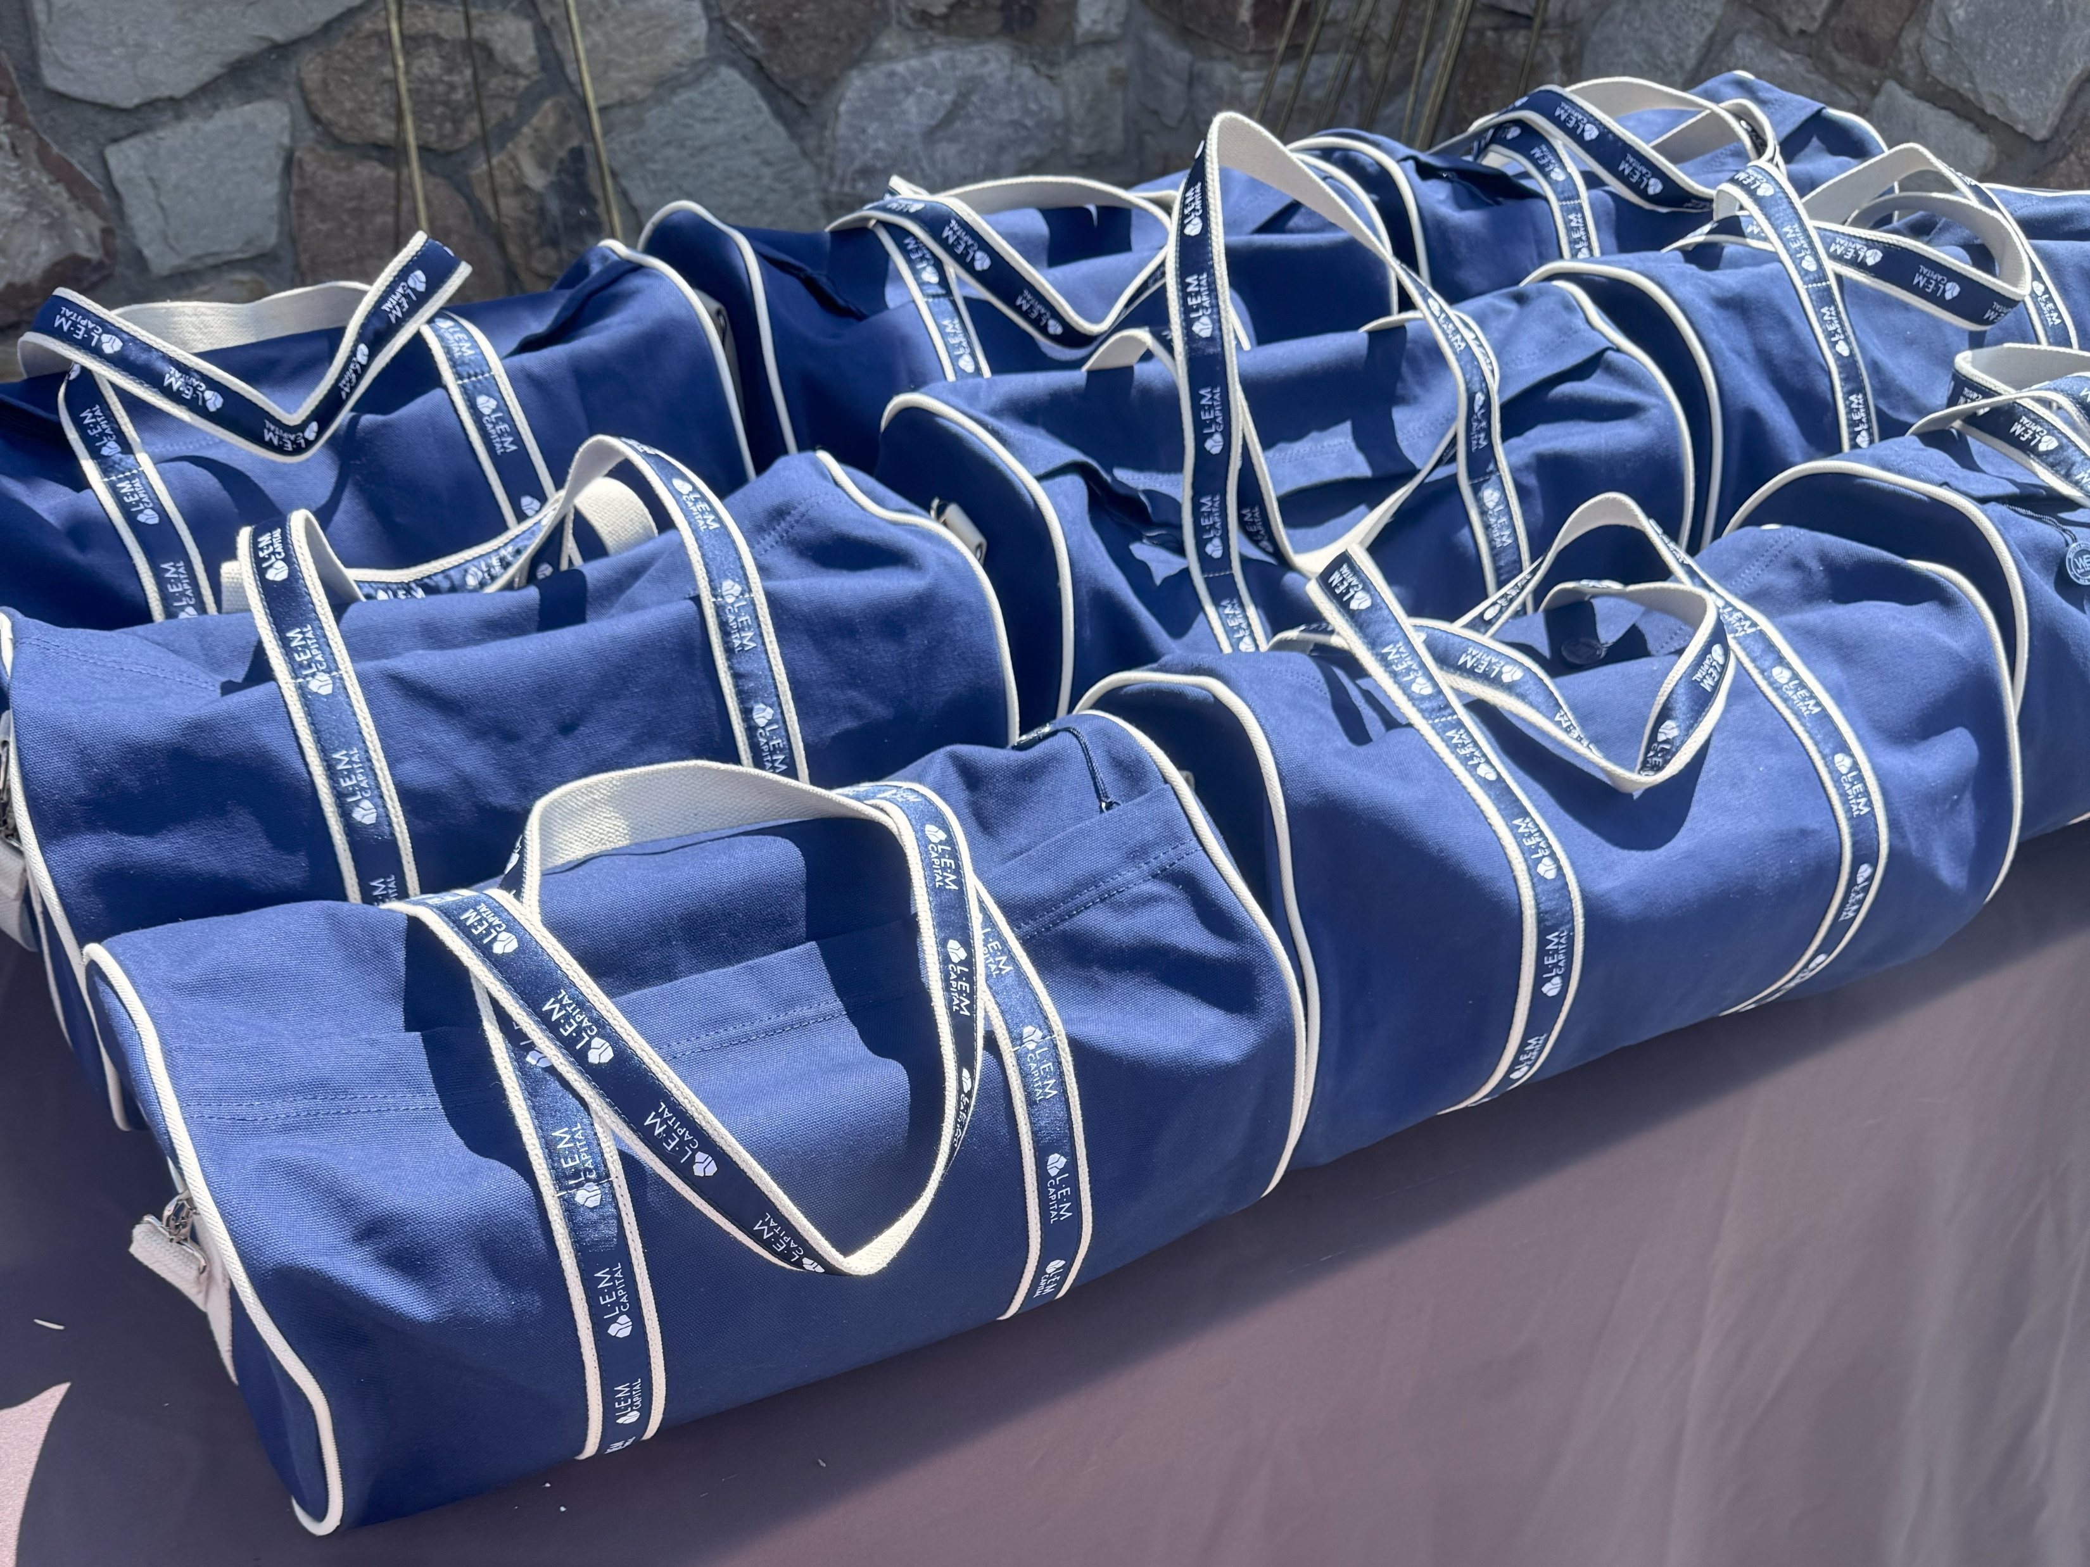




2025 Charity Golf Benefit
LEM Capital Charity Golf Benefit Raises Over $80,000 for Habitat for Humanity Philadelphia

Slide 3

3rd Annual Charity Golf Outing
Presented by LEM Capital & JLL

Slide 4
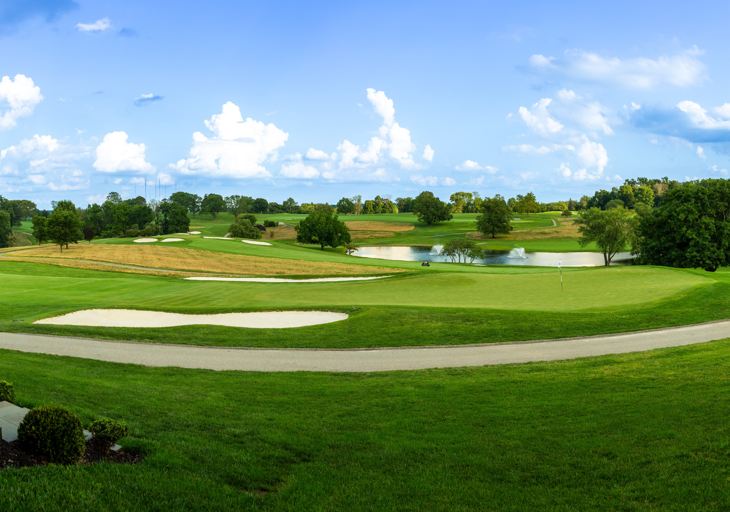

SAVE THE DATE
Annual Charity Golf Outing
Presented by LEM Capital & JLL –
Hosted by the Philadelphia country club

Slide 5
SAVE THE DATE
Annual Charity Golf Outing
Presented by LEM Capital & JLL –
Hosted by the Philadelphia country club & THE RACQUET CLUB OF PHILADELPHIA

Slide 6
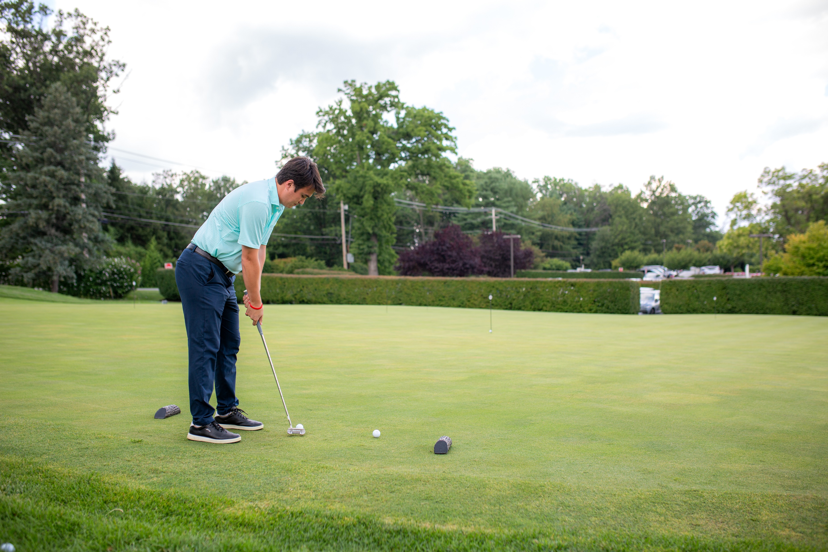
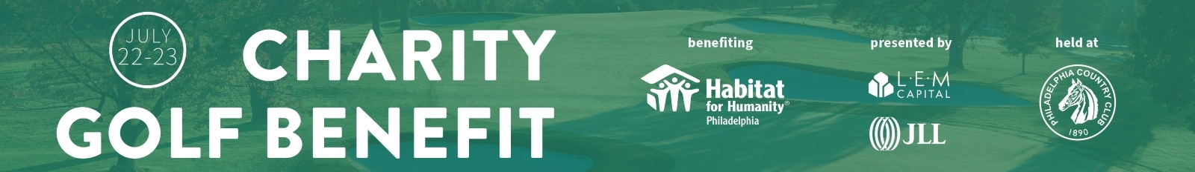
Get ready to tee off and have a blast!
Our tournament is all about a shotgun start format but, you will also get to test your skills in challenges like:
⛳️ Furthest drive
⛳️ Closest to the pin
⛳️ Chipping
⛳️ Putting
Win awesome prizes! Plus, don't miss out on our silent auction!

